Slide 1
Uber Exploratory Data Analysis

Slide 2
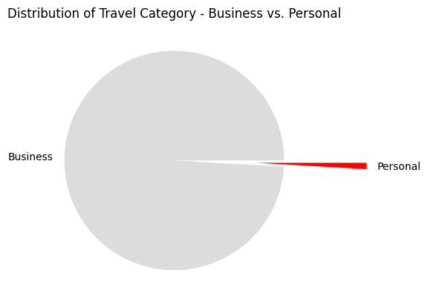
Recommendation:
Some offers might be launched to encourage customers to prefer Uber for Personal Travel
Only 1% of the travel, used for personal purpose which is alarming!
99%

Slide 3
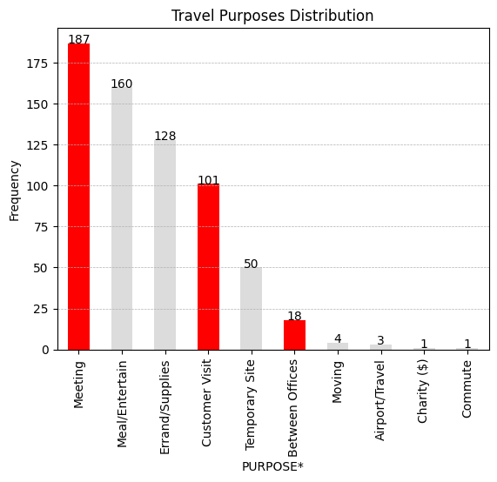
With over 99% of travel based on Business,
There could be three types of meeting:
Meeting with Supplier
Meeting with Customer
Meeting with fellow teams
With 101 travels based on ‘Customer visit’,
Meeting ‘Between Offices’ could be,
Meeting in-between teams of same company in different locations
Meeting with the Supplier
In such scenario, what could be ‘Meeting’ be?
Meeting between two parties (Suppliers / Customers) that is outside both the party’s office?
It’s unlikely to have so many meetings that is not between offices / customer visit
Difference between Meeting – Customer Visit – Between Offices?

Slide 4
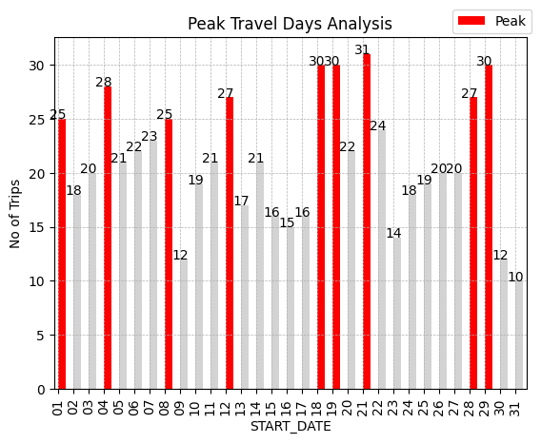
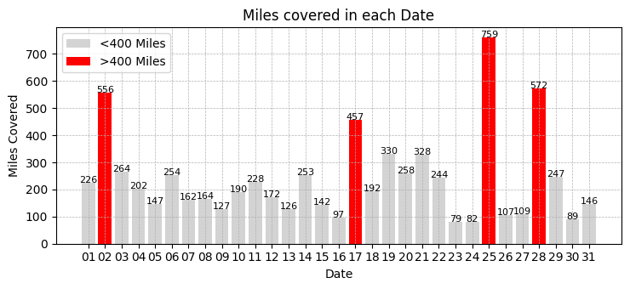
Out of 31 days, 9 days has peak travel bookings in a month with over 25 bookings in a day
Peak Consecutive Travel days where more than 20 bookings happen in a day
4th – 8th
18th – 21st
28th, 29th & 1st
Peak Travel days always has miles covered less than 400 with 28th being an exception

Slide 5
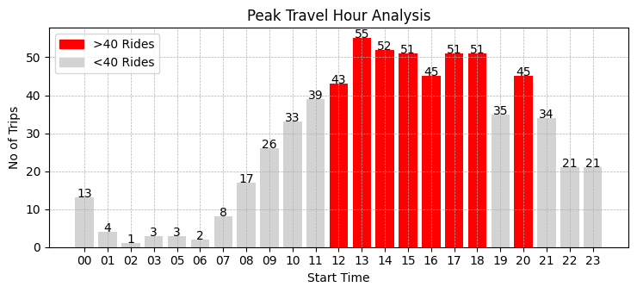
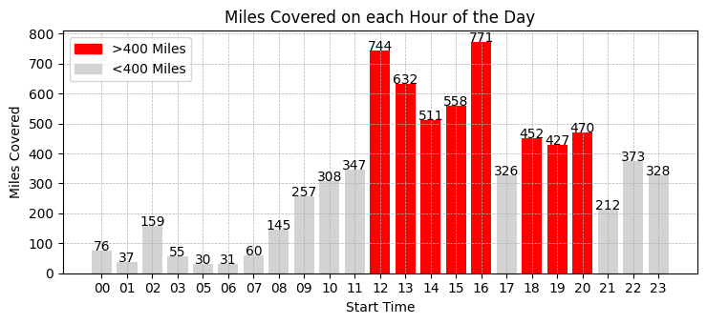
Peak Time : 12:00PM – 06:00PM
08:00PM (Dinner Time)
There is almost a linear lead-up (07:00AM – 11:00AM) towards the peak hour of the day
17th has so many rides and very less miles covered.

Slide 6
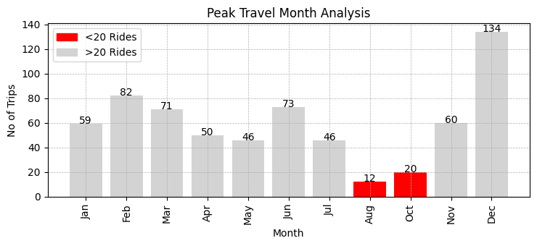
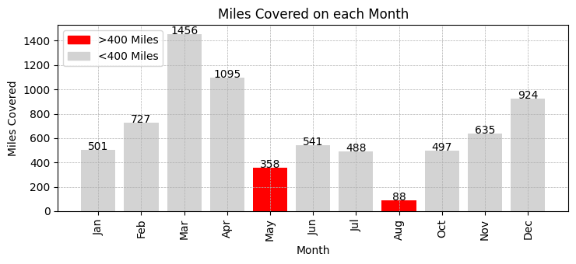
September Data Missing!
Aug & Oct has very less data. Potential Data loss since Sep data is missing already
March – 1456 miles covered in just 71 rides
With 99% purpose of travel being business, financial year end could be the reason for so much of travel
Holiday times in Dec could be the reason for so much travel.

Slide 7
